Slide 1
Java RMI
(Remote Method Invocation)

Slide 2
Tài liệu tham khảo
Advanced Java Networking 118
Java Network Progr. & Distributed 255
Core Java 2 : 405

Slide 3
Overview
Remote Method Invocation (RMI) is a distributed systems technology that allows one Java Virtual Machine (JVM) to invoke object methods that will be run on another JVM located elsewhere on a network.
RMI is a Java technology that allows one JVM to communicate with another JVM and have it execute an object method. Objects can invoke methods on other objects located remotely as easily as if they were on the local host machine
Each RMI service is defined by an interface, which describes object methods that can be executed remotely. This interface must be shared by all developers who will write software for that service—it acts as a blueprint for applications that will use and provide implementations of the service.

Slide 4
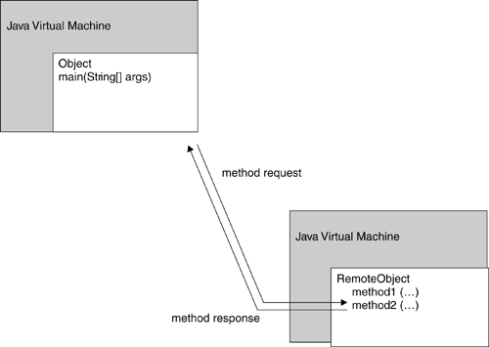
Overview
Invocation of a method on a remote object, executing on a remote machine

Slide 5
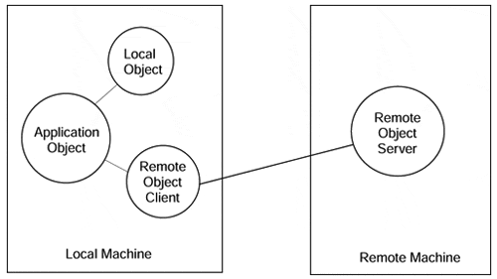
Overview
Invocations on remote objects appear the same as invocations on local objects.

Slide 6
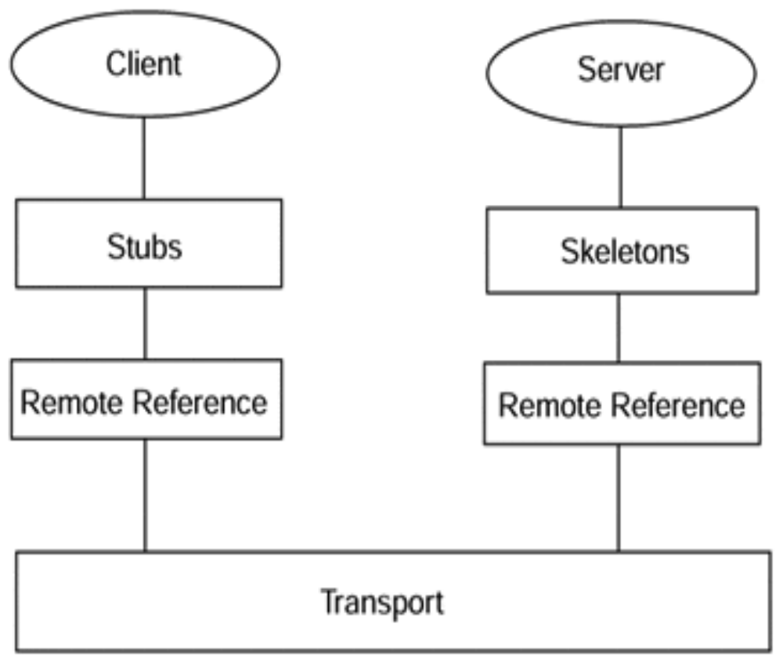
Overview
Java RMI architecture.

Slide 7
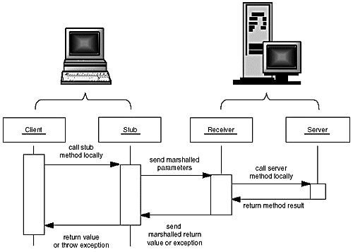
Parameter marshalling

Slide 8
Stubs and Parameter Marshalling
When client code wants to invoke a remote method on a remote object, it actually calls an ordinary method of the Java programming language that is encapsulated in a surrogate object called a stub. The stub resides on the client machine, not on the server. The stub packages the parameters used in the remote method into a block of bytes.
The process of encoding the parameters is called parameter marshalling. The purpose of parameter marshalling is to convert the parameters into a format suitable for transport from one virtual machine to another.

Slide 9
Stubs and Parameter Marshalling
The stub method on the client builds an information block that consists of:
  An identifier of the remote object to be used;
  A description of the method to be called;
  The marshalled parameters.
The stub then sends this information to the server.
On the server side, a receiver object performs the following actions for every remote method call:
  It unmarshals the parameters.
  It locates the object to be called.
  It calls the desired method.
  It captures and marshals the return value or exception of the call.
  It sends a package consisting of the marshalled return data back to the stub on the client.
The client stub unmarshals the return value or exception from the server. This value becomes the return value of the stub call.

Slide 10
RMI Applications
RMI applications are often comprised of two separate programs: a server and a client.
A typical server application creates some remote objects, makes references to them accessible, and waits for clients to invoke methods on these remote objects.
A typical client application gets a remote reference to one or more remote objects in the server and then invokes methods on them. RMI provides the mechanism by which the server and the client communicate and pass information back and forth.
Such an application is sometimes referred to as a distributed object application.

Slide 11
Creating Distributed Applications Using RMI
Design and implement the components of your distributed application.
Compile sources and generate stubs.
Make classes network accessible.
Start the application.
Design and Implement the Application Components
Defining the remote interfaces: A remote interface specifies the methods that can be invoked remotely by a client.
Implementing the remote objects: Remote objects must implement one or more remote interfaces. The remote object class may include implementations of other interfaces (either local or remote) and other methods (which are available only locally).
Implementing the clients: Clients that use remote objects can be implemented at any time after the remote interfaces are defined, including after the remote objects have been deployed.

Slide 12
Designing a Remote Interface
Your client program needs to manipulate server objects, but it doesn't actually have copies of them. The objects themselves reside on the server. The client code must still know what it can do with those objects.
Any system that uses RMI will use a service interface. The service interface defines the object methods that can be invoked remotely, and specifies parameters, return types, and exceptions that may be thrown.
All RMI service interfaces extend the java.rmi.Remote interface, which assists in identifying methods that may be executed remotely. To define a new interface for an RMI system, you mustdeclare a new interface extending the Remote interface and All the methods in those interfaces must also declare that they will throw a RemoteException.
// shared by client and server
interface Product extends Remote {
String getDescription() throws
RemoteException;
}

Slide 13
Designing a Remote Interface
package rmidemo;
import java.rmi.*;
public interface Product extends Remote{
String getDescription() throws RemoteException;
}

Slide 14
Implementing a Remote Interface
In general the implementation class of a remote interface should at least
  Declare the remote interfaces being implemented
  Define the constructor for the remote object
  Provide an implementation for each remote method in the remote interfaces
The server needs to create and to install the remote objects. This setup procedure can be encapsulated in a main method in the remote object implementation class itself, or it can be included in another class entirely. The setup procedure should
  Create and install a security manager
  Create one or more instances of a remote object
  Register at least one of the remote objects with the RMI remote object registry (or another naming service such as one that uses JNDI), for bootstrapping purposes

Slide 15
Implementing a Remote Interface
import java.rmi.*;
import java.rmi.server.*;
public class ProductImpl extends UnicastRemoteObject implements Product {
private String name;
public ProductImpl(String n) throws RemoteException {
super();
name = n;
}
public String getDescription() throws RemoteException {
return "I am a " + name + ". Buy me!";
}
}

Slide 16
Naming conventions for RMI classes
Product A remote interface
ProductImpl A server class implementing that interface
ProductImpl_Stub A stub class that is automatically generated by the rmic program
ProductImpl_Skel A skeleton class that is automatically generated by the rmic program needed for SDK 1.1
ProductServer A server program that creates server objects
ProductClient A client program that calls remote methods

Slide 17
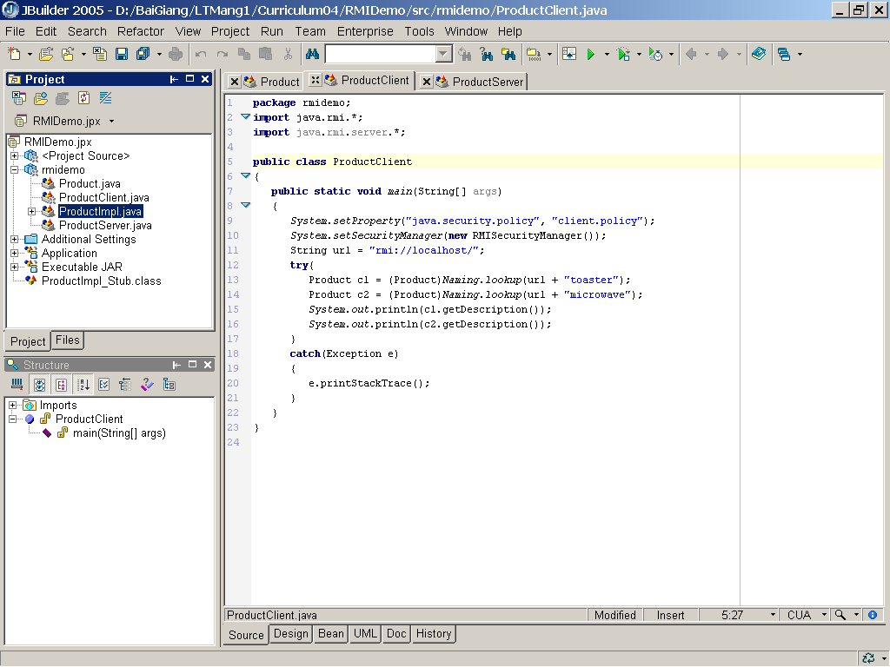
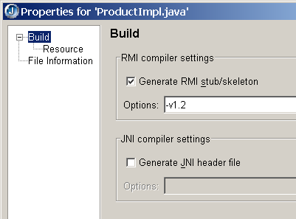
Creating Stub and Skeleton Classes

Slide 18
Creating an RMI Server
import java.rmi.*;
import java.rmi.server.*;
public class ProductServer {
public static void main(String args[]) {
try {
System.out.println("Constructing server implementations...");
// Load the service
ProductImpl EOS350D = new ProductImpl("Canon EOS 350D");
// Examine the service, to see where it is stored
RemoteRef location = EOS350D.getRef();
System.out.println (location.remoteToString());
// Load the service
ProductImpl nikon70D = new ProductImpl("Nikon 70D");
// Examine the service, to see where it is stored
location = nikon70D.getRef();
System.out.println (location.remoteToString());

Slide 19
Creating an RMI Server
System.out.println ("Binding server implementations to registry...");
// Registration format: rmi://registry_hostname :port /service
// Note the :port field is optional
// Register with service so that clients can find us
Naming.rebind("rmi://localhost/EOS350D", EOS350D);
Naming.rebind("rmi://localhost/nikon70D", nikon70D);
System.out.println ("Waiting for invocations from clients...");
}
catch (RemoteException re) {
System.err.println ("Remote Error - " + re);
}
catch (Exception e) {
System.out.println(e.getMessage());
}
}
}

Slide 20
Starting the server
Our server program isn't quite ready to run, yet. Because it uses the bootstrap RMI registry, that service must be available. To start the RMI registry under UNIX, you execute the statement
rmiregistry &
Under Windows, call
start rmiregistry
at a DOS prompt or from the Run dialog box. (The start command is a Windows command that starts a program in a new window.)
Now you are ready to start the server. Under UNIX, use the command:
java ProductServer &
Under Windows, use the command:
start java ProductServer

Slide 21
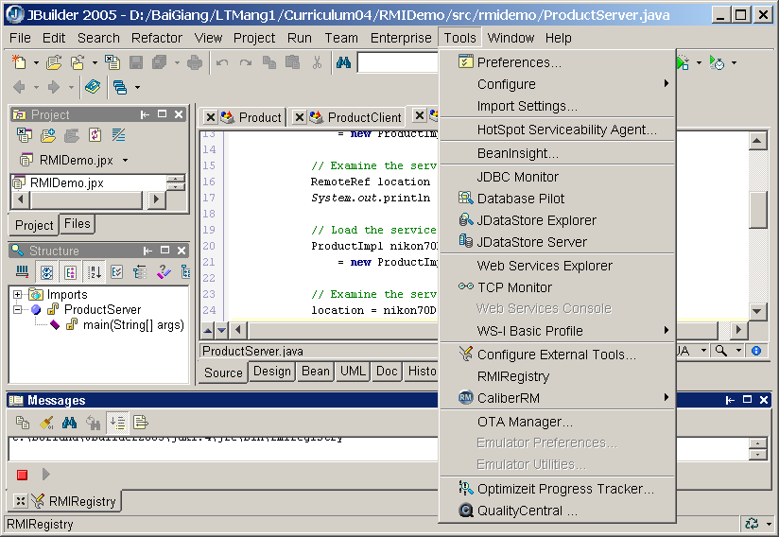
Starting the server

Slide 22
Creating an RMI Client
public class ProductClient {
public static void main(String[] args) {
System.setProperty("java.security.policy", "client.policy");
System.setSecurityManager(new RMISecurityManager());
// Registration format: rmi://registry_hostname :port /service
// Note the :port field is optional
String url = "rmi://localhost/";
try{
// Lookup the service in the registry, and obtain a remote service
Remote remoteService1 = Naming.lookup(url + "EOS350D");
Remote remoteService2 = Naming.lookup(url + "nikon70D");
// Cast to a Product interface
Product c1 = (Product) remoteService1;
Product c2 = (Product) remoteService2;
System.out.println(c1.getDescription());
System.out.println(c2.getDescription());
}
catch(Exception e) {
e.printStackTrace();
} }}

Slide 23
Running the client
By default, the RMISecurityManager restricts all code in the program from establishing network connections. But the program needs to make network connections
  To reach the RMI registry;
  To contact the server objects.
To allow the client to connect to the RMI registry and the server object, you need to supply a policy file.. Here is a policy file that allows an application to make any network connection to a port with port number at least 1024. (The RMI port is 1099 by default, and the server objects also use ports 1024.)
grant {
permission java.net.SocketPermission
"*:1024-65535", "connect";
};
In the client program, we instruct the security manager to read the policy file, by setting the java.security.policy property to the file name.
System.setProperty("java.security.policy", "client.policy")

Slide 24
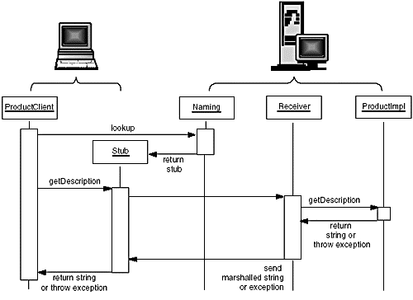
Calling the remote getDescription method

Slide 25
Creating RMI Program Step by Step
Steps to run this sample:
Compile the project (Project | Rebuild project "SimpleRMI.jpx").
Start the RMI registry (Tools | RMIRegistry).
Start the server class (check VM java.rmi.server.codebase and java.rmi.server.policy settings, Project |Project properties…).
Run the client program (right-click SimpleRMIClient.java, select Run).
Or use the runtime configuration, SimpleRMIClient for Unix or Windows

Slide 26
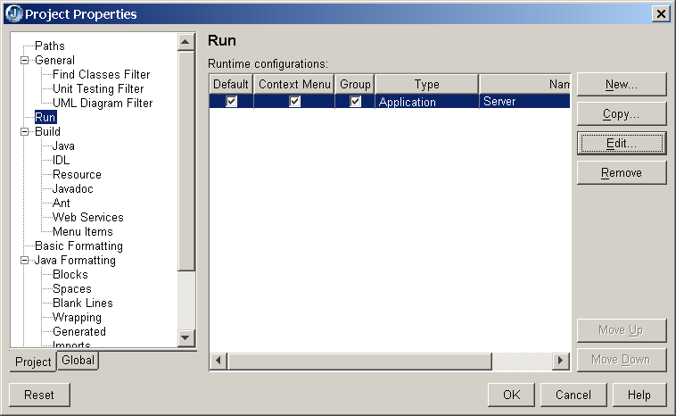
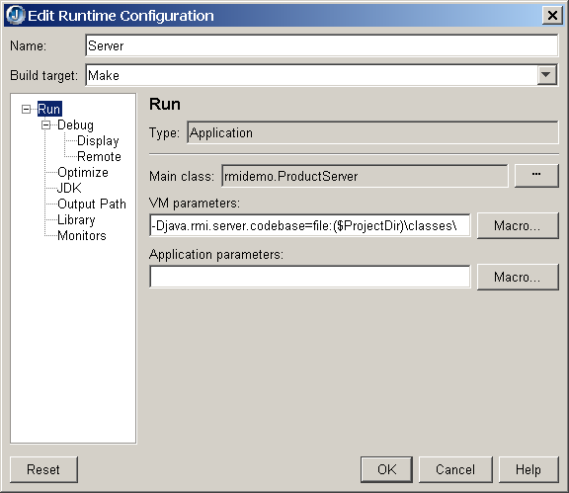
Start the server class

Slide 27
1.Create an interface
The interface created for this example is SimpleRMIInterface.java. It contains only one method; the method takes no arguments and returns an object of type java.util.Date. Note two things about this interface:
It extends the java.rmi.Remote interface (all interfaces used in RMI must do this).
The method throws a java.rmi.RemoteException (every method in a remote object's interface must specify this exception in its "throws" clause; this exception is a superclass of all RMI exceptions that can be thrown.

Slide 28
2. Create a class that implements the interface.
In this example, the implementation is found in SimpleRMIImpl.java. This class must extend java.rmi.UnicastRemoteObject and must implement the interface you created in step 1. In this example, the only method that needs to be implemented is getDate(), which returns the current date and time on the system. Note 2 things about the constructor:
The call to super().
The call to Naming.rebind(name, this). This call informs the RMI registry that this object is available with the name given in "String name".
Other than that, this object simply implements all the methods declared in the interface

Slide 29
3. Create a server that creates an instance of the "impl" class.
In this example, the server class is SimpleRMIServer.java. In this case, the server is pretty simple. It does 2 things:
Installs a new RMISecurityManager (Note that RMI uses a different security manager from the security manager used for applets).
Creates an instance of the SimpleRMIImpl class, and gives it the name "SimpleRMIImpl instance". The SimpleRMIImpl object takes care of registering the object with the RMI registry. After this code is run, the object will be available to remote clients as "//<your server here>/ SimpleRMIImpl instance". (and in fact, this is how the client connects to it in step 4).

Slide 30
Steps 4 - 6
Create a client that connects to the server object using Naming.lookup().
In this example, the client class is SimpleRMIClient.java. The client first installs a new RMI Security Manager (see previous step), then uses the static method Naming.lookup() to get a reference to the remote object. Note that the client is using the interface to hold the reference and make method calls. You should make sure you've created your interface before you try to build the client.
Set the compile options on the RMI implementation file.
In the IDE, Right-click the SimpleRMIImpl.java file in the navigator pane and choose "Properties..." In the properties dialog, check "Generate RMI stub/skeleton", enter "-v1.2" in the Options field, and click OK.
Compile the project by selecting Project | Rebuild project "SimpleRMI.jpx" from the menu.

Slide 31
7. Start the RMI registry.
Now you're setting up the environment so that you can run it. From within JBuilder, you can select Tools | RMIRegistry to start the RMI registry. The next time you look at the tools menu, you will notice there is a check next to this menu option. This is your clue that the registry is running. Selecting it again will close the RMI registry. Alternatively, you can start the RMI registry from the command-line. The name of the executable varies by platform, but typically begins with "rmiregistry" and resides in the jre/bin directory of your JDK installation.
Note: The RMI registry must be started before you can start your server.

Slide 32
8.Start the RMI server program.
It is necessary to grant an RMI server special security rights in order for it to listen for and accept client RMI requests over a network. Typically, these rights are specified in a java security policy file defined by a special property (java.security.policy) passed via a command-line argument to the VM of the server. Similarly, a property specifying the location of classes used by the server (java.rmi.server.codebase) is also passed to the server's VM via a command-line argument. Before running the server, select Project | Project properties... and select the "Run" tab of the dialog to inspect the parameters passed to the server's VM.
Next, select "Run | Run project" from the menu to start the rmi server. When the message "SimpleRMIImpl ready" appears, the server is ready to accept client requests. A message like "connection refused" indicates that either your rmiregistry is not running, or the java.security.policy parameter does not point to the proper location of the SimpleRMI.policy file.

Slide 33
9. Run the RMI client program.
It is necessary to grant an RMI client special security rights in order for it to connect to an RMI server over a network. Typically, these rights are specified in a java security policy file defined by a special property (java.security.policy) passed via a command-line argument to the VM of the client. Before running the client, select Run | Configurations... | "Run SimpleRMI Client" | <Edit> to inspect the parameters passed to the client's VM.
Next, to run the client.
SimpleRMIClient asks the RMI registry to lookup a reference to the rmi object named "SimpleRMIImpl instance" created by SimpleRMIServer. After SimpleRMIClient then uses this reference to invoke the method declared in the SimpleRMIInterface interface just as if the object were a local object. It receives a java.util.Date object from the server (indicating the current time on the server) and displays its contents.

Slide 34
RMI Applications for JDK 1.5
pregenerating a stub class for a remote object's class is only required if the remote object needs to support pre-5.0 clients. As of the 5.0 release, if a pregenerated stub class for a remote object's class cannot be loaded when the remote object is exported, the remote object's stub class is generated dynamically.
Designing a Remote Interface
Implementing a Remote Interface
Creating a RMI Server
Createing a RMI Client

Slide 35
RMI Applications for JDK 1.5
Creating a RMI Server
Installs a new RMISecurityManager
System.setProperty("java.security.policy", "client.policy"); System.setSecurityManager(new RMISecurityManager());
Both the server and client applications use a security policy file that grants permissions only to files in the local class path (the current directory). The server application needs permission to accept connections, and both the server and client applications need permission to make connections. The permission java.net.SocketPermission is granted to the specified codebase URL, a "file:" URL relative to the current directory. This permission grants the ability to both accept connections from and make connections to any host on unprivileged ports (that is ports >= 1024).
grant codeBase "file:." {
permission java.net.SocketPermission "*:1024-", "connect,accept";
};

Slide 36
RMI Applications for JDK 1.5
Creating a RMI Server
Creates and exports a Registry instance on the local host that accepts requests on the specified port
Registry RMIReg = LocateRegistry.createRegistry(1099);
Creates a remote object
ProductImpl EOS350D = new ProductImpl("Canon EOS 350D");
Binds a remote reference to the specified name in this registry
RMIReg.bind("EOS350D", EOS350D);

Slide 37
RMI Applications for JDK 1.5
Creating a RMI Client
Installs a new RMISecurityManager
System.setProperty("java.security.policy", "client.policy");
System.setSecurityManager(new RMISecurityManager());
Getss a reference to the remote object Registry on the specified host and port. If host is null, the local host is used.
Registry RMIReg = LocateRegistry.getRegistry("localhost",1099);
Lookups the service in the registry, and obtain a remote service
Remote remoteService1 = RMIReg.lookup("EOS350D");
Cast to a Remote (Product) interface
Product c1 = (Product) remoteService1;

